Slide 1
Visual motion analysis of the player’s finger
IACV project 2023
Emanuele Paesano, Alessio Hu

Slide 2
Problem formulation
Goal:
extract the sequence of notes of a song, using only image analysis and computer vision tools and concepts.
Tools:
Python
MediaPipe
Opencv-python
Tensorflow

Slide 3
Implementation

Slide 4
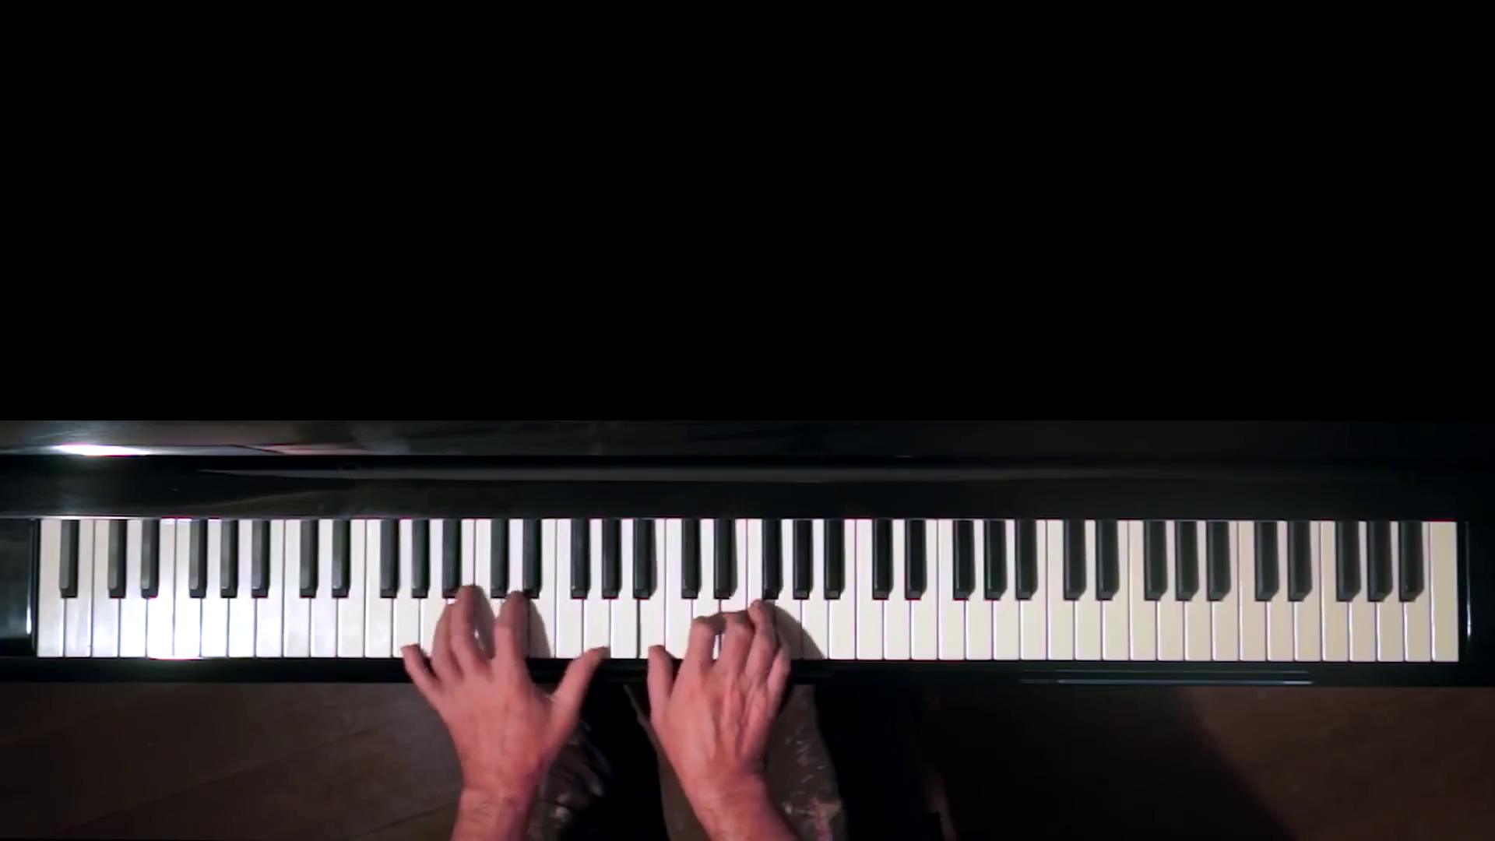
Data and camera setup
Data extracted from YouTube videos
Camera placed above the piano

Slide 5
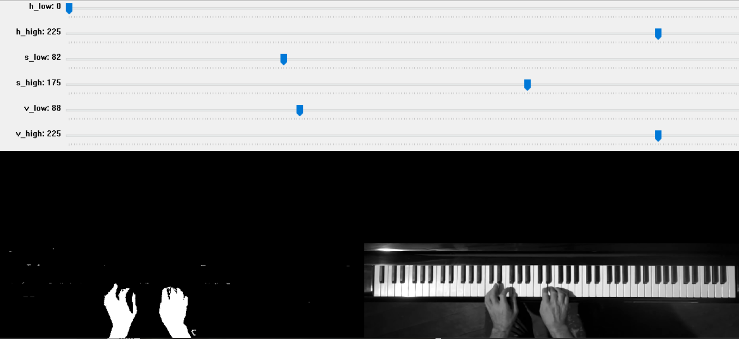
Hand and keyboard segmentation
a) Manual extraction - HSV value thresholding

Slide 6
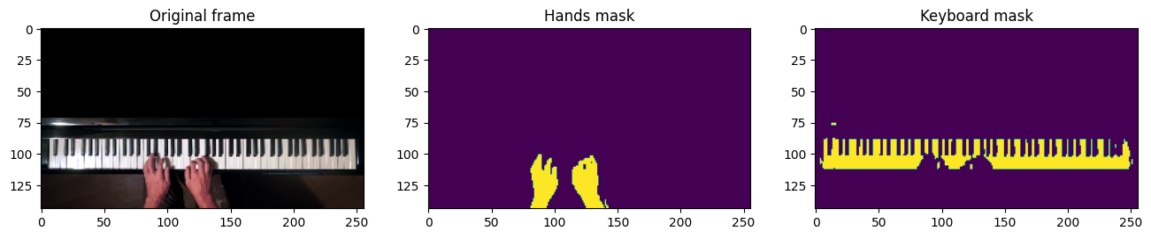
Hand and keyboard segmentation
b) Neural network segmentation - Train on manually selected masks

Slide 7
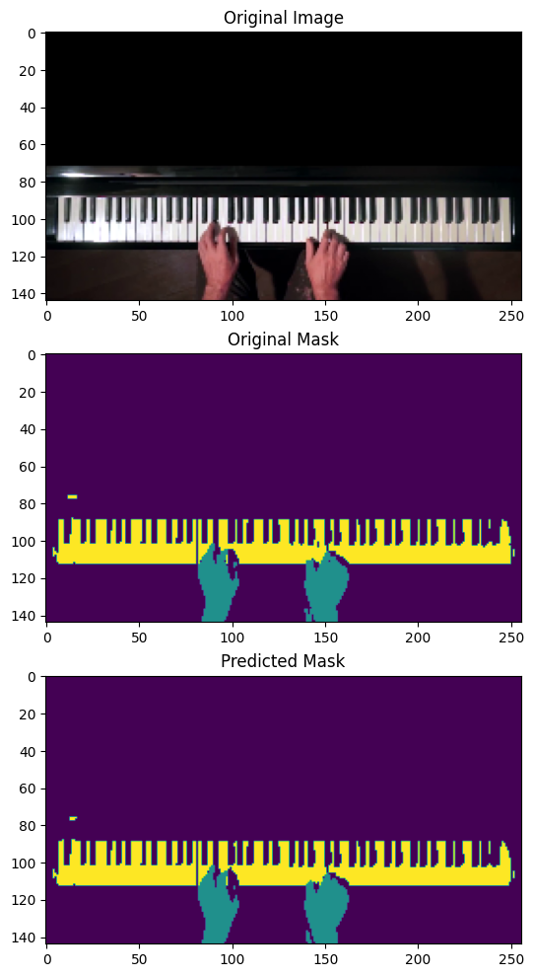
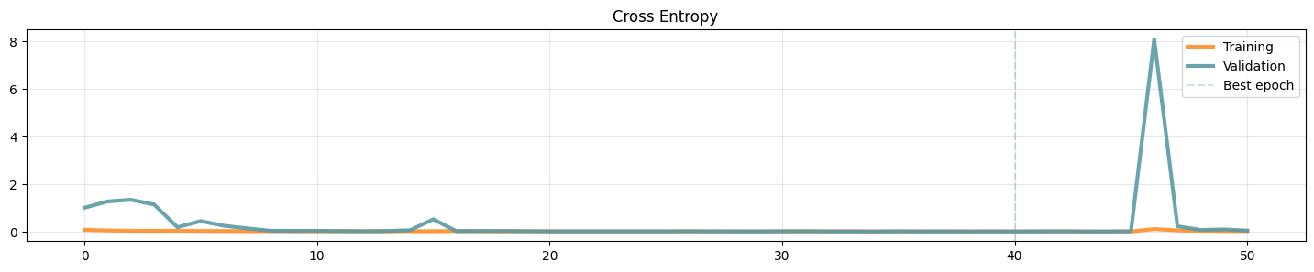
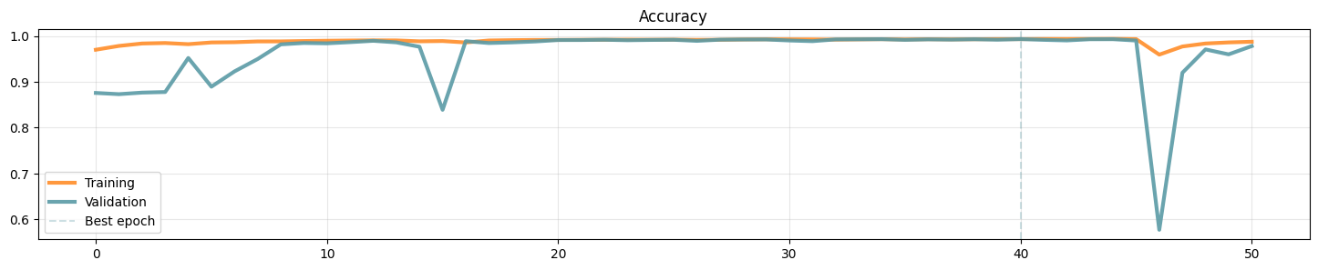
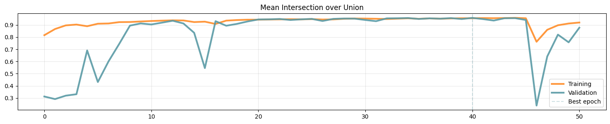

Slide 8
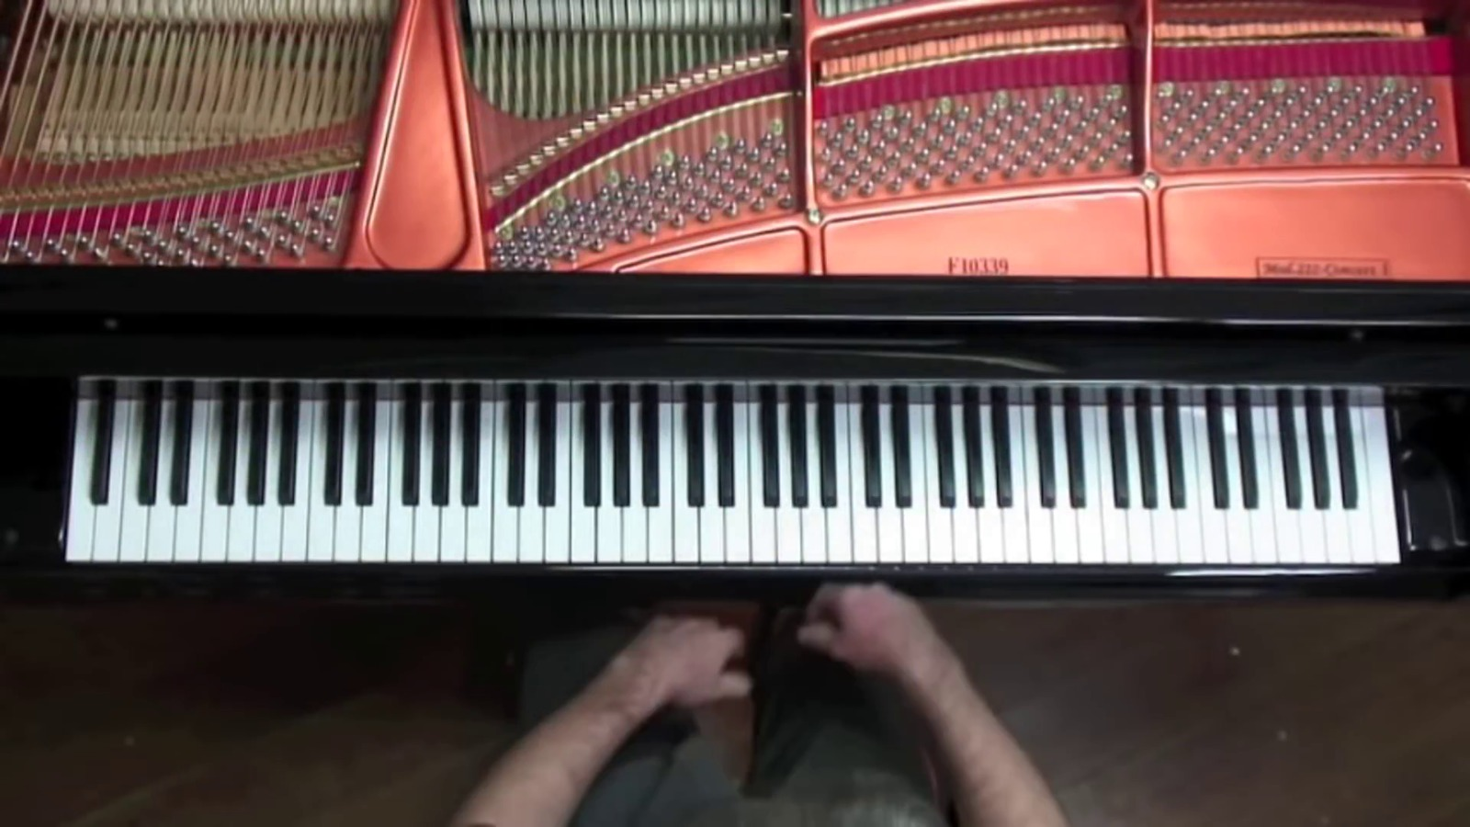
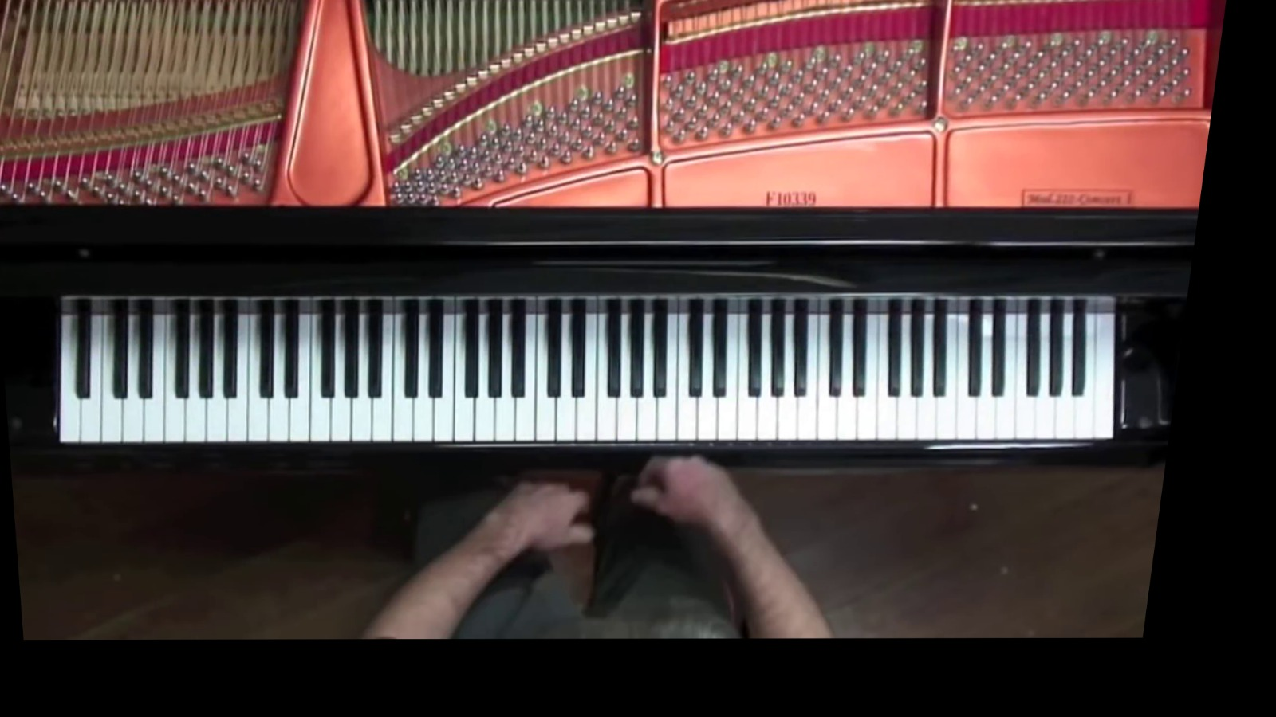
Keyboard rectification
Horizontal keyboard is the ideal setting
Compute homography between keyboard and ideal shape

Slide 9
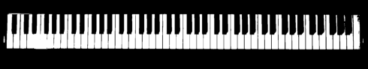
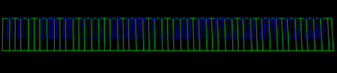
Key regions retrieval
Map every piano key to a well defined region
Exploit patterns of 1’s and 0’s to detect black and white keys

Slide 10
Detection of pressed keys
1) use shadows to select candidate keys
WHITE KEYS:
NOT
OR
=
(3)
(2)
AND
=
(1)

Slide 11
BLACK KEYS:
NOT
=
AND
=
(2)
(1)
XOR
=
XOR
(3)

Slide 12
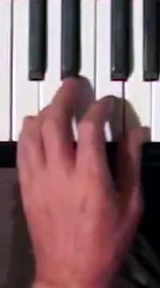
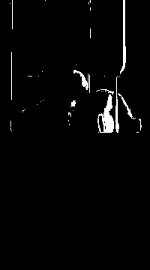
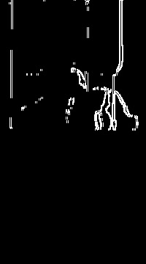
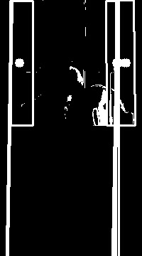
2) Exclude small shadows keys keys through Sobel and Hough lines
ORIGINAL
WHITE
SHADOWS MASK
SOBEL
HOUGH

Slide 13
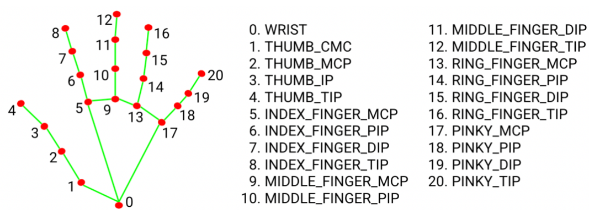
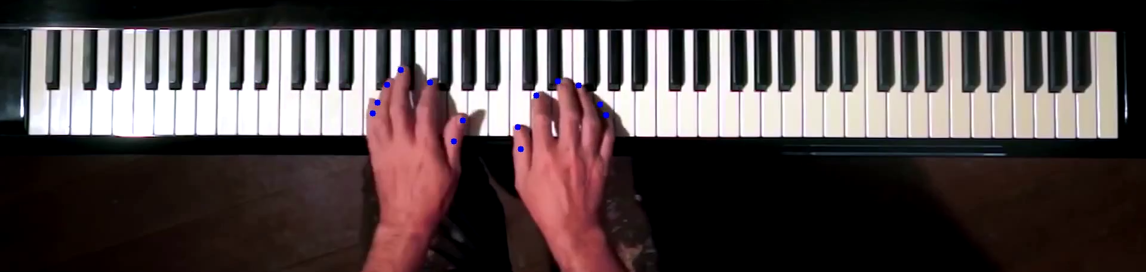
3) Use MediaPipe to find finger positions

Slide 14
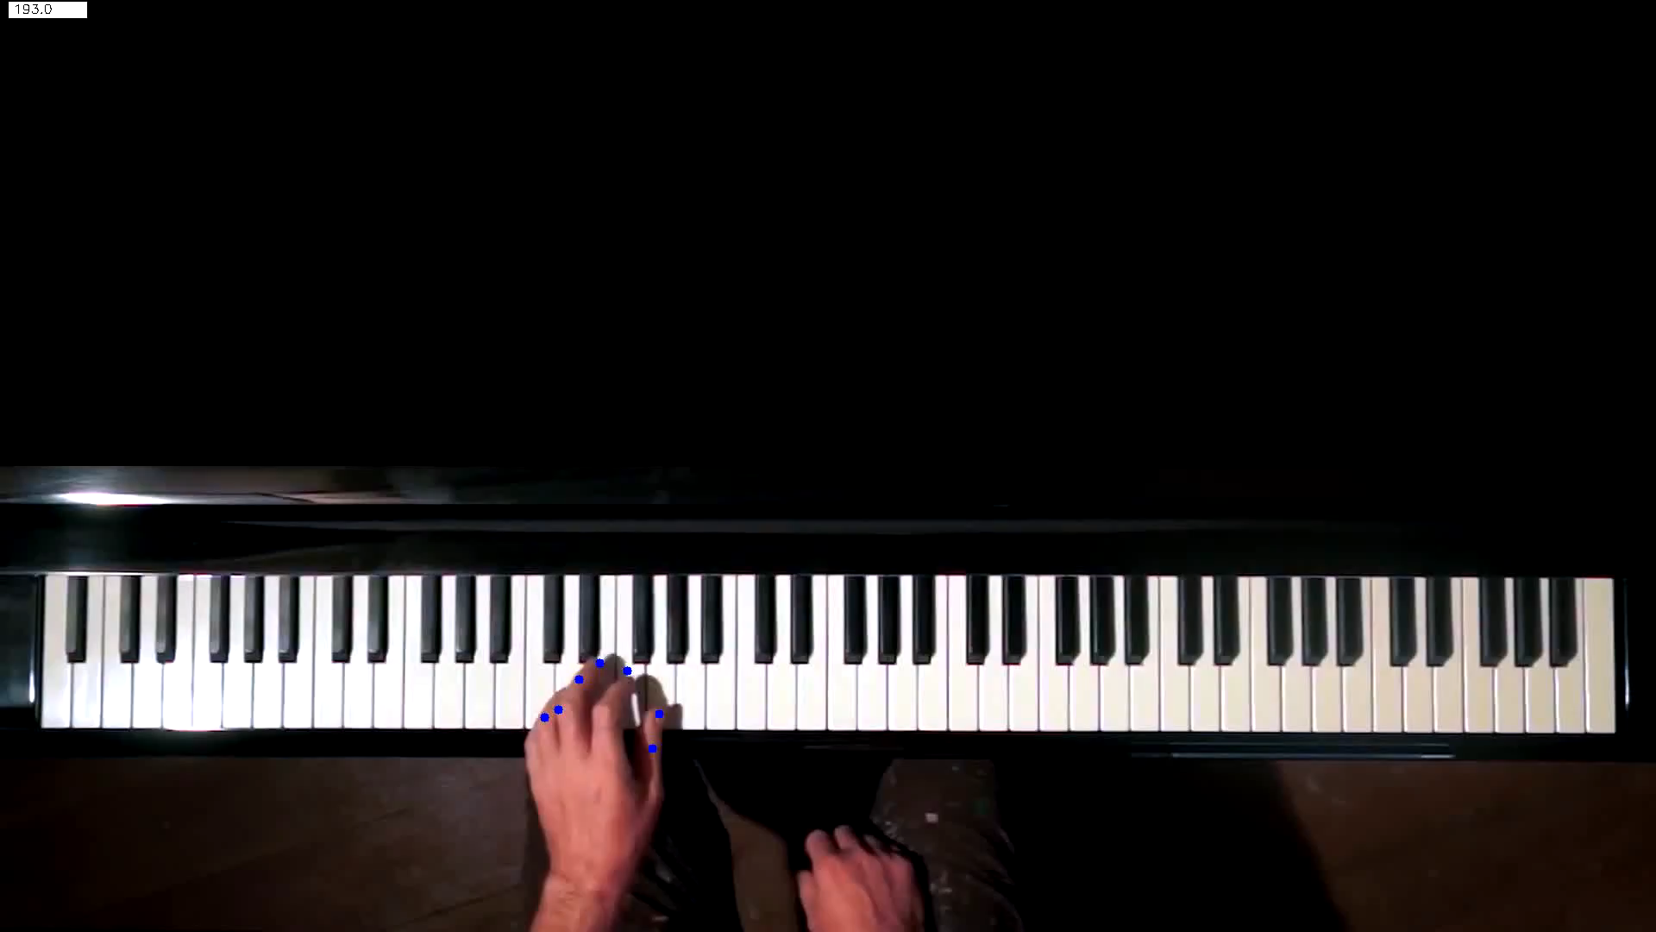
4) Final selection of pressed keys

Slide 16
Results

Slide 17

With manual mask:
With neural network:

Slide 18
Conclusions
Successfully recreate the song
Possible further implementation could include:
Extend method to other instruments (accordion)
Improve neural network performance

